Slide 1

Real-Time System Diagnostics
& Health Monitoring Bharath Rajiv A Bharani Aswath R
Kamal Roshan K S
Chennai Institute of Technology / Rooks

Slide 2
Business Need/ Opportunity
Identification of Business Problem
Need Assessment
Value Proposition

Slide 3
Business Problem/Need/Opportunity
Real-Time System Diagnostics & Health Monitoring
Proactive Maintenance: Real-time system diagnostics and health monitoring can help detect issues early, before they cause major problems or downtime. This allows for proactive maintenance and can help prevent costly repairs and outages.
Increased Efficiency: By continuously monitoring the health of systems, organizations can identify and address issues that are causing inefficiencies or slow performance. This can lead to improved productivity and reduced costs.
Improved Security: Real-time monitoring and diagnostics can help detect and prevent security breaches by identifying potential vulnerabilities and anomalous behavior. This can help protect sensitive data and reduce the risk of data breaches.
Compliance and Auditing: Many industries have strict regulations and compliance requirements for system monitoring and diagnostics. Real-time monitoring and diagnostics can help organizations meet these requirements and provide the necessary data for auditing and reporting.
Predictive Maintenance: Real-time system diagnostics and health monitoring can also provide data that can be used for predictive maintenance. By analyzing data from the monitored systems, organizations can predict when certain parts or components are likely to fail, allowing for proactive replacement or repair, reducing downtime and maintenance costs.

Slide 4
Market Potential
Target Segment / Market Sizing

Slide 5
Target Segment/Market Size
Industrial organizations: Industrial organizations often have complex systems such as machines and equipment that need to be continuously monitored to ensure optimal performance and to prevent breakdowns. Real-time system diagnostics and health monitoring can be particularly valuable for these organizations, as it can help to prevent equipment failures and downtimes.
Small and medium-sized businesses (SMBs): SMBs often have limited IT resources and may not have in-house expertise for monitoring and diagnosing issues with their systems. A real-time system diagnostics and health monitoring service can help SMBs improve the efficiency and uptime of their systems, without the need to hire additional staff.
Data centers and hosting providers: Data centers and hosting providers need to ensure that their systems are always available and performant. Real-time system diagnostics and health monitoring can help these organizations detect and resolve issues quickly, minimizing downtime and improving customer satisfaction.

Slide 6
Business model
Subscription-based service: Customers would pay a monthly or annual fee for access to the system monitoring service. They would have access to real-time monitoring and diagnostic tools for their systems, as well as alerts and notifications for any issues that arise.
Pay-per-use: Customers would pay for monitoring services on an as-needed basis, rather than a subscription. This could include a one-time fee for an initial diagnosis or a per-incident fee for troubleshooting and problem resolution.
Remote monitoring and management: The system would be designed to allow for remote monitoring and management, which would enable the business to provide services to customers remotely, reducing the need for on-site visits and increasing scalability.
Integration with other tools: The system could be integrated with other tools such as CRM, Ticketing and inventory management systems, to offer a complete solution to the customers and streamline the process.

Slide 7
Solution Details
Explanation/Articulation of Solution Idea
Differentiation/ Unique Selling Proposition
Solution Demo

Slide 8
Solution Details
The proposed solution is to develop a dashboard that can provide real-time diagnosis of an industrial machine by using sensor data and a machine learning model. The dashboard is designed to be an efficient tool that can help in predicting the machine's state, recommending appropriate times for maintenance, and generating tickets for machines that need service or have reached a point of failure.

Slide 9
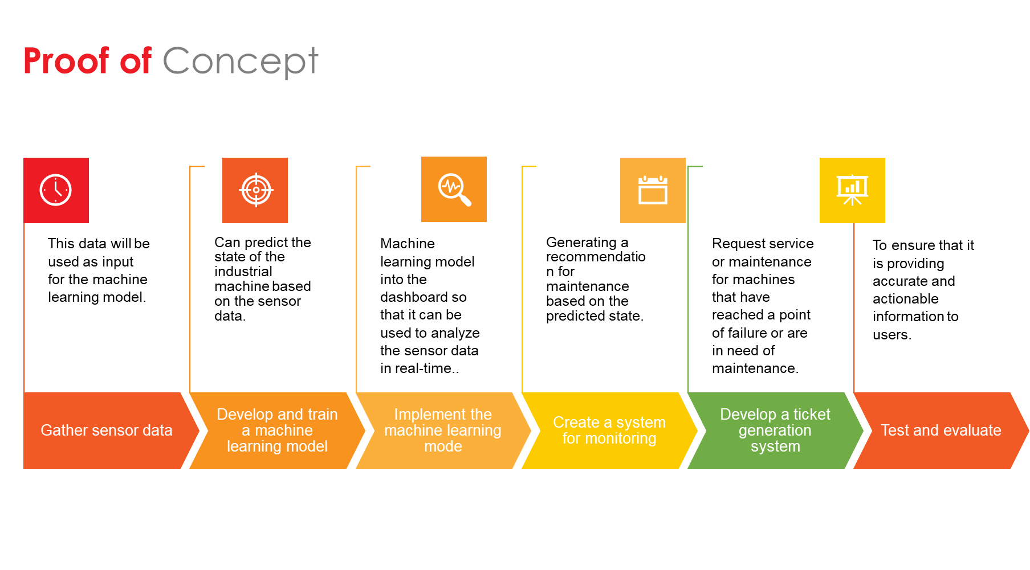

Slide 10
Future Readiness
Solution Roadmap
Cross-Industry application

Slide 11
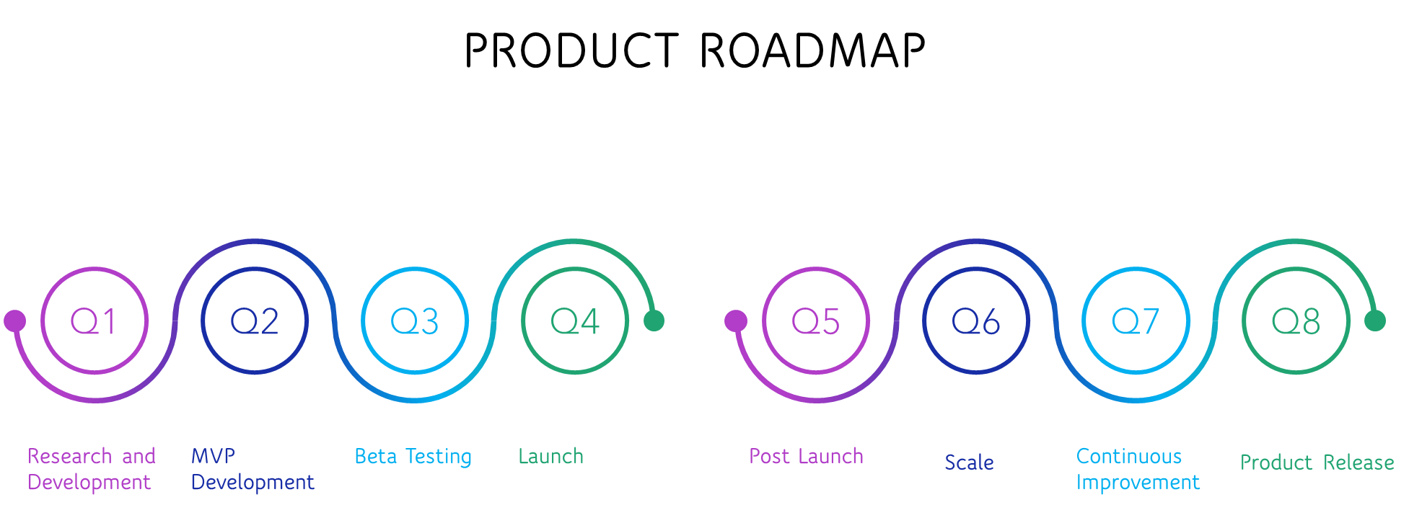

Slide 12
Future Readiness
RoadMap
Research and Development: Conduct market research to identify target segments, assess customer needs and the competition, and gather information about industry regulations and compliance requirements. Use this information to develop a product or service that meets the needs of the target market.
MVP development: Develop a Minimum Viable Product (MVP) that can be used to test the concept and gather feedback from potential customers. The MVP should include the core features and functionalities of the service, but it does not need to be fully polished.
Beta testing: Conduct beta testing with a small group of customers to gather feedback and identify any issues or areas for improvement. Use this feedback to refine the product or service before launching.
Launch: Launch the real-time system diagnostics and health monitoring service, and begin marketing and promoting the service to potential customers.

Slide 13
Post-launch: Track customer feedback and usage data, and use this information to improve the service and add new features. Develop partnerships and collaborations with other companies in the industry to expand the service offerings and reach more customers.
Scale: Scale the service by increasing the number of customers, expanding the service offerings and developing new revenue streams.
Continuous improvement: Continuously gather customer feedback and usage data, and use this information to improve the service and add new features. Stay updated with the latest technologies and trends in the industry to ensure that the service remains competitive.
*This roadmap is flexible and it can be adjusted based on the resources available, the target market and the competition.

Slide 14
About the Team

Slide 15
TEAM Members
Introduce your team members
Team Leader:
Bharath Rajiv A – B.TECH Artificial Intelligence and Data Science, 3rd year
Team Members:
Kamal Roshan K S – B.TECH Artificial Intelligence and Data Science , 3rd year
Bharani Aswath R– B.TECH Artificial Intelligence and Data Science , 3rd year

Slide 16
Thank You
Notes:
Leading industry analysts and awards organizations have recognized Virtusa for our exceptional quality in digital engineering and transformational IT capabilities.
Highlights:
Virtusa's vLife™ platform in the Best New Product or Service of the Year - Health & Pharmaceuticals - Product category. vLife™ is a ready-to-use collaborative platform, built on a large clinical data lake that models disease progression or population-level risk categorization. By unifying data, AI, and IoT, Virtusa is helping the healthcare market address key pain points.

